Slide 1

Joins including inner, outer and self joins
Database Management System | SQL and Advanced Query Formulation
Course: Database Management System | Chapter: SQL and Advanced Query Formulation | Program: Bachelor of Engineering
DISCOVER · LEARN · EMPOWER
Notes:
Welcome everyone to today's session on SQL and Advanced Query Formulation. We will dive deep into the mechanics of joining tables, a critical skill for any database professional. As Chandigarh University students, mastering these concepts will empower you to solve complex data retrieval challenges efficiently.

Slide 2
Course Outcomes
SLIDE 2 / 14
Course Outcome
CO | BT LEVEL | DESCRIPTION
CO1 | BT2 | Explain database architecture, relational model concepts and formal query language foundations including relational algebra and relational calculus.
CO2 | BT3 | Apply relational algebra, relational calculus and SQL constructs to formulate correct and efficient database queries.
CO3 | BT4 | Analyze functional dependencies and design normalized relational schemas up to 5NF ensuring lossless join and dependency preservation.
CO4 | BT4 | Analyze transaction schedules and concurrency control mechanisms to determine serializability, recoverability and correctness.
CO5 | BT5 | Evaluate storage structures, indexing strategies and query optimization techniques for performance, scalability and reliability.
Chandigarh University
2 / 14
Notes:
Today's lecture directly addresses our Course Outcomes. CO1 is covered as we explore the relational algebra foundations of joins. CO5 is addressed when we discuss how different join types impact query optimization and storage performance in real-world systems.

Slide 3
Learning Objectives
SLIDE 3 / 14
Learning Outcomes
1
Define the fundamental concept of a database join operation.
2
Differentiate between inner, outer, and self join types clearly.
3
Construct SQL queries using various join syntaxes correctly.
4
Analyze the results of joins on sample numerical datasets.
5
Identify common pitfalls when formulating complex join statements.
Chandigarh University
3 / 14
Notes:
By the end of this lecture, you will be able to define joins and distinguish between their types. You will learn to construct correct SQL queries and analyze their results on sample data. Finally, we will identify common pitfalls to ensure your queries are robust and error-free.

Slide 4
Lecture
SLIDE 4 / 14
Definition of Database Joins
1
A join combines rows from two or more tables based on related columns.
2
The operation relies on a common column, typically a primary or foreign key.
3
Joins allow retrieval of data that is logically related but physically separated.
4
The result is a temporary virtual table containing combined data from inputs.
5
Without joins, complex queries would require multiple separate database calls.
Chandigarh University
4 / 14
Notes:
Think of a join as a bridge connecting two islands of data. If you have a student table and a course table, a join lets you see which student took which course in one view. This virtual table is created dynamically without altering the physical storage of your data.

Slide 5
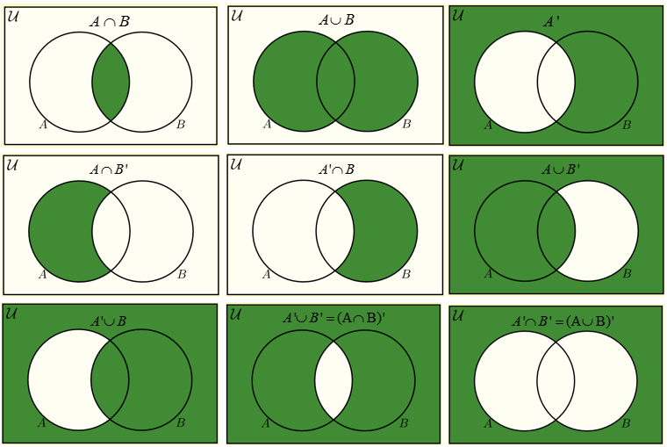
Lecture
SLIDE 5 / 14
Inner Join Mechanics
1
Inner Join returns only rows where the join condition is true for both tables.
2
Rows without matching values in the other table are excluded from results.
3
This is the most common join type for finding exact relationships.
4
The result set size is always less than or equal to the smallest input table.
5
It effectively filters out orphan records that lack corresponding parent data.
Source: www.onlinemathlearning.com
Chandigarh University
5 / 14
Notes:
An inner join is like a strict filter that only keeps what matches perfectly. If a student has no enrolled courses, they will not appear in an inner join result. This ensures data integrity by showing only established relationships between your entities.

Slide 6
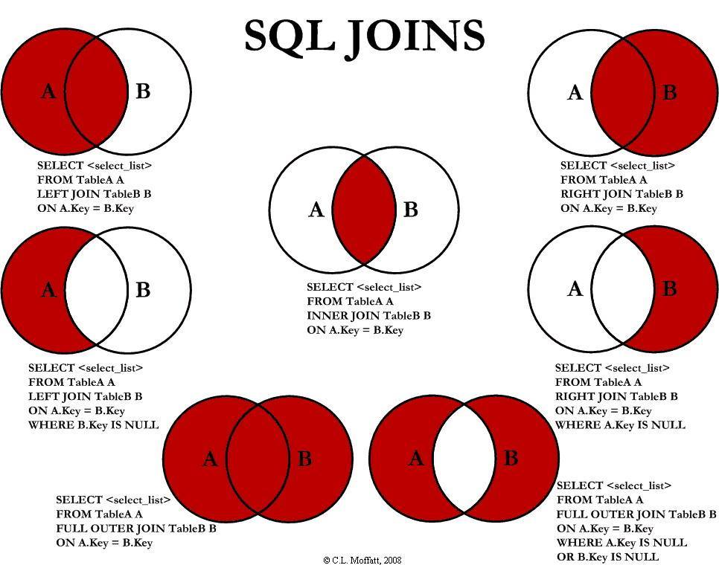
Lecture
SLIDE 6 / 14
Outer Join Variants
1
Left Outer Join returns all rows from the left table and matches from the right.
2
Right Outer Join returns all rows from the right table and matches from the left.
3
Full Outer Join returns all rows from both tables, filling gaps with nulls.
4
Null values appear in columns where no matching row exists in the other table.
5
Outer joins are essential for finding missing or orphaned records in datasets.
Source: i.redd.it
Chandigarh University
6 / 14
Notes:
Outer joins are crucial when you need to see everything, even if there is no match. For example, a Left Join will show all students, even those who haven't registered for any courses yet. The unmatched columns will simply display null values to indicate the absence of data.

Slide 7
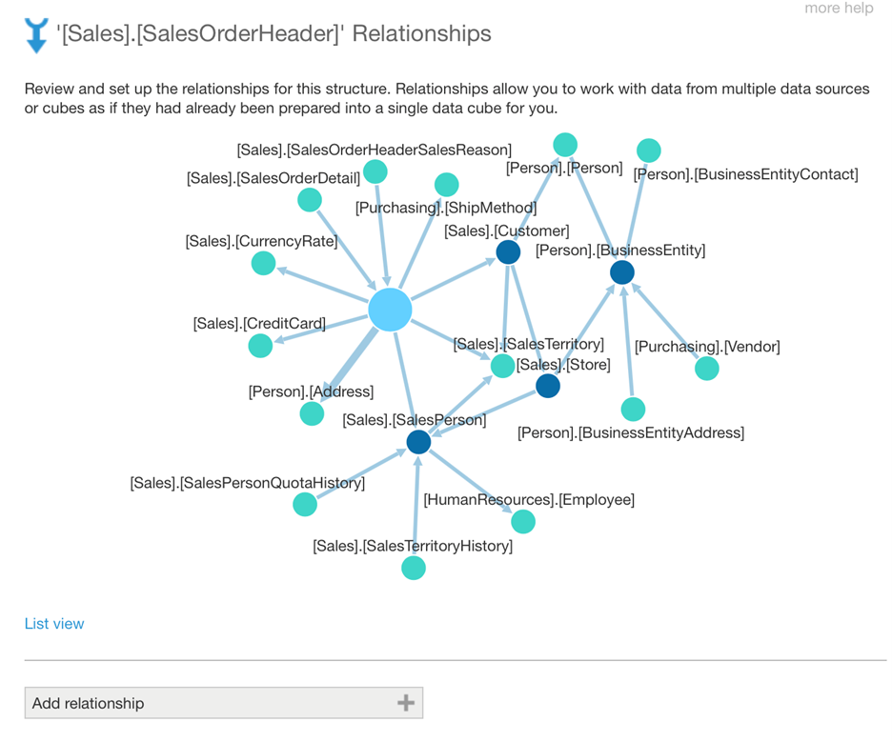
Lecture
SLIDE 7 / 14
Self Join Concept
1
A self join allows a table to be joined with itself using aliases.
2
It is used to compare rows within the same table structure.
3
Commonly used for hierarchical data like employee-manager relationships.
4
Aliases are mandatory to distinguish between the two instances of the table.
5
The join condition typically compares a column to another column in the same table.
Source: www.dundas.com
Chandigarh University
7 / 14
Notes:
A self join is like looking in a mirror to compare yourself with your reflection. In an employee table, you might join the table to itself to find who manages whom. You must use aliases, like E1 for Employee and M1 for Manager, to avoid confusion.

Slide 8
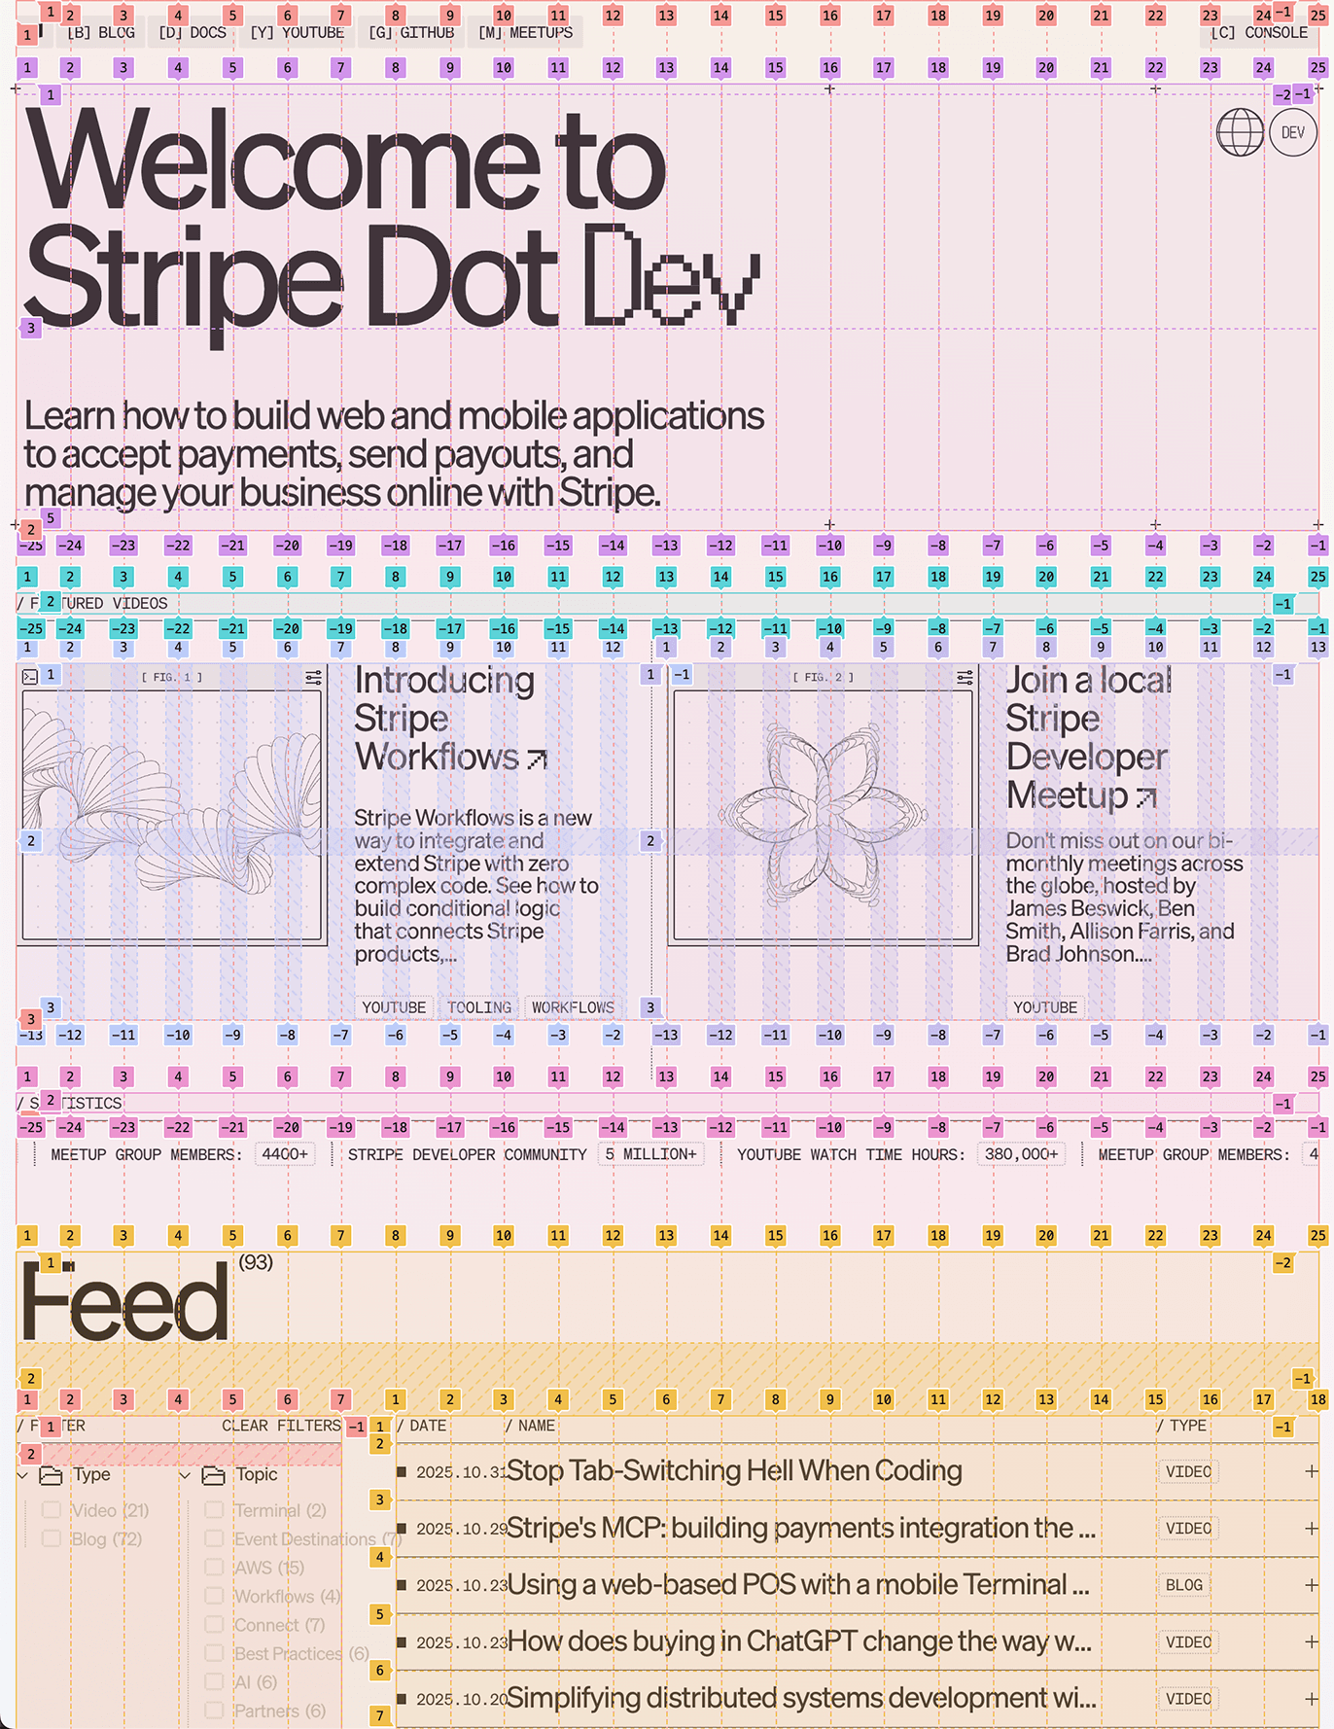
Worked Example
SLIDE 8 / 14
Inner Join
1
Table A has IDs 1, 2, 3 and Table B has IDs 2, 3, 4.
2
Inner Join on ID returns rows with IDs 2 and 3 only.
3
Row with ID 1 from A is excluded because it has no match in B.
4
Row with ID 4 from B is excluded because it has no match in A.
5
Result contains exactly the intersection of the two ID sets.
Source: www.joshwcomeau.com
Chandigarh University
8 / 14
Notes:
Let's look at a numerical example. If Table A has IDs 1, 2, 3 and Table B has 2, 3, 4, an inner join returns only 2 and 3. The ID 1 from A and ID 4 from B are dropped because they don't match. This demonstrates how inner joins strictly filter for existence.

Slide 9
Worked Example
SLIDE 9 / 14
Left Outer Join
1
Table A has IDs 1, 2, 3 and Table B has IDs 2, 3, 4.
2
Left Join on ID returns rows with IDs 1, 2, and 3 from Table A.
3
Row with ID 1 from A appears with null values for Table B columns.
4
Rows with IDs 2 and 3 match and display combined data from both tables.
5
Row with ID 4 from B is completely ignored in the result set.
Chandigarh University
9 / 14
Notes:
In a Left Join, we keep everything from the left table. So, ID 1 from Table A appears, but the columns from Table B will be null. IDs 2 and 3 show combined data. This is vital for reporting where you need to list all items, even if some have no sales.

Slide 10
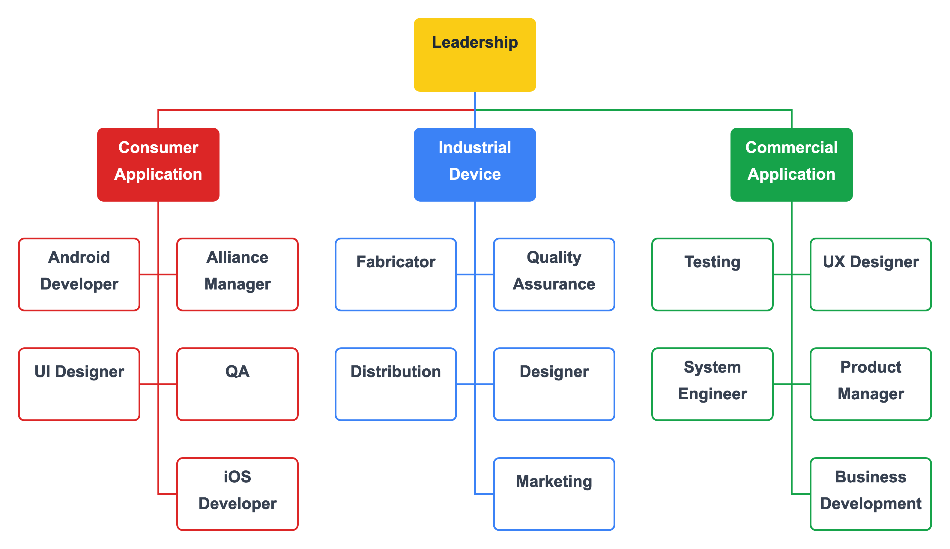
Worked Example
SLIDE 10 / 14
Self Join
GOVERNING EQUATION
Join condition: Employees.Manager_ID = Employees.ID
1
Table 'Employees' has columns: ID, Name, and Manager_ID.
2
Query retrieves Employee Name and their corresponding Manager Name.
3
Row for ID 101 (Manager) appears as a manager for ID 102 (Employee).
4
The root manager (ID 100) appears with null for their own manager name.
Source: lexchart.com
Chandigarh University
10 / 14
Notes:
Consider an employee table where ID 101 is the manager of ID 102. A self join links the Manager_ID of 102 to the ID of 101. This allows us to list the employee name alongside their manager's name. The top boss will have a null value for their manager, indicating no superior.

Slide 11
Common Pitfalls
SLIDE 11 / 14
Cartesian Product
1
Missing a join condition results in a Cartesian product of all rows.
2
If Table A has 100 rows and Table B has 100 rows, result has 10,000 rows.
3
This causes massive performance degradation and memory exhaustion issues.
4
Always verify that a valid ON clause exists in your join statement.
5
Cartesian products are rarely the intended outcome in practical queries.
Chandigarh University
11 / 14
Notes:
A common mistake is forgetting the ON clause, which creates a Cartesian product. If you join two tables of 100 rows each without a condition, you get 10,000 rows. This is a performance killer and usually indicates a logic error in your query formulation.

Slide 12
Common Pitfalls
SLIDE 12 / 14
NULL Handling
1
NULL values in join columns prevent matching in Inner Joins.
2
Outer Joins preserve rows with NULLs but display NULL in output.
3
Comparing NULL to any value using standard equality operators returns unknown.
4
Use IS NULL or IS NOT NULL operators for explicit null checks.
5
Understanding NULL semantics is critical for accurate data retrieval logic.
Chandigarh University
12 / 14
Notes:
NULLs behave uniquely in SQL. In an inner join, a NULL in the join column means no match, so the row is dropped. In outer joins, the row is kept, but the joined columns show NULL. Always remember that NULL is not equal to NULL, requiring special operators.

Slide 13
Lecture
SLIDE 13 / 14
Key Takeaways
1
Joins combine tables based on related columns to form a unified view.
2
Inner joins filter for matches, while outer joins preserve unmatched rows.
3
Self joins enable hierarchical queries within a single table structure.
4
Missing join conditions lead to inefficient Cartesian products.
5
Proper NULL handling is essential for accurate query results.
Chandigarh University
13 / 14
Notes:
To summarize, joins are the backbone of relational queries. You must choose the right type: inner for strict matches, outer for inclusive lists, and self for hierarchies. Always watch out for Cartesian products and handle NULLs with care to ensure your data is accurate.

Slide 14
Lecture
SLIDE 14 / 14
References
1
Fundamentals of Database Systems — Ramez Elmasri & Shamkant B. Navathe
2
Database System Concepts — Silberschatz, Korth & Sudarshan
3
Database Management Systems — Raghu Ramakrishnan & Johannes Gehrke
4
Oracle/MySQL Documentation — Oracle
Chandigarh University
14 / 14
Notes:
For further reading, please refer to the standard texts by Elmasri, Silberschatz, and Ramakrishnan. These books provide deep theoretical and practical insights into database systems. The Oracle and MySQL documentation is also an excellent resource for specific syntax implementations.

